Slide 1
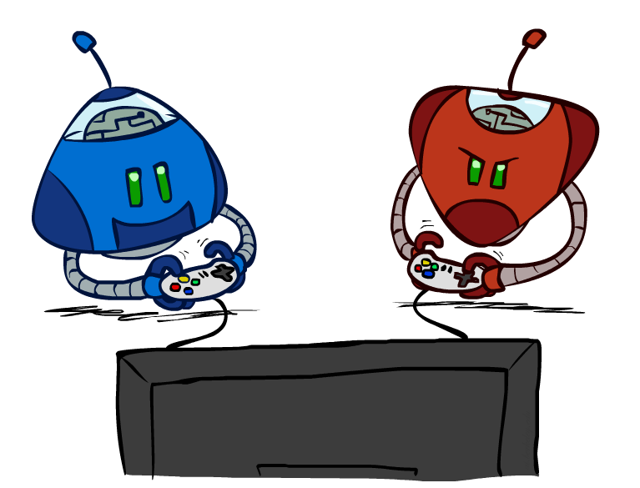
Artificial Intelligence
Adversarial Search
CS 444 – Spring 2021
Dr. Kevin Molloy
Department of Computer Science
James Madison University
Much of this lecture is taken from
Dan Klein and Pieter Abbeel AI class at UC Berkeley

Slide 2
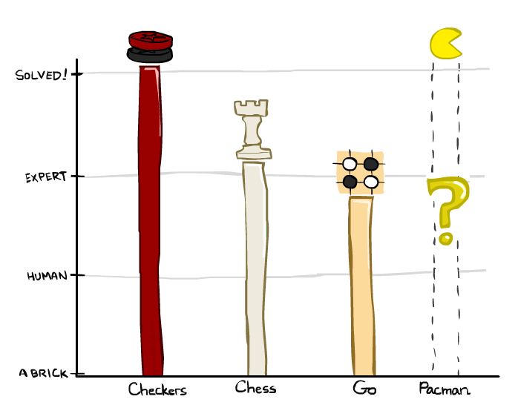
Today
Checkers: 1950: First computer player. 1994: First computer champion: Chinook ended 40-year-reign of human champion Marion Tinsley using complete 8-piece endgame. 2007: Checkers solved!
Chess: 1997: Deep Blue defeats human champion Gary Kasparov in a six-game match. Deep Blue examined 200M positions per second, used very sophisticated evaluation and undisclosed methods for extending some lines of search up to 40 ply. Current programs are even better, if less historic.
Go: Human champions are now starting to be challenged by machines. In go, b > 300! Classic programs use pattern knowledge bases, but big recent advances use neural networks developed by Google's DeepMind research group (Alpha Go -- https://deepmind.com/research/case-studies/alphago-the-story-so-far)
Pacman
Figure from Berkley AI

Slide 3
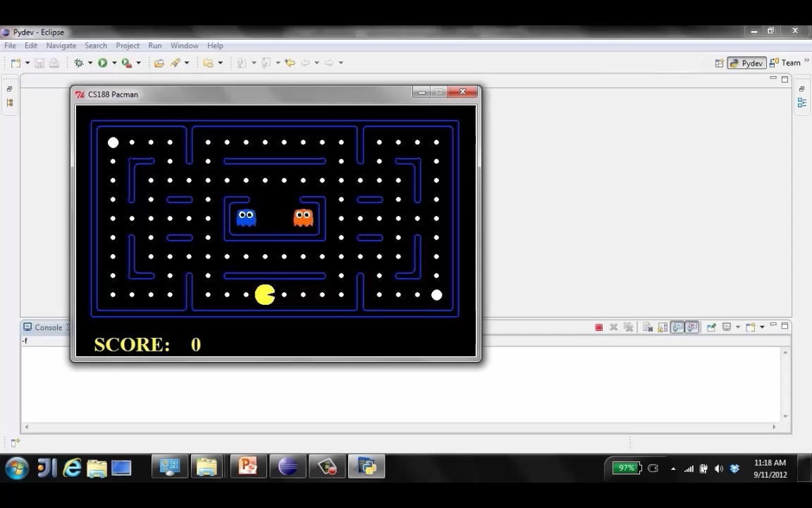
What is Going On Under the Covers?
Figure from Berkley AI

Slide 4
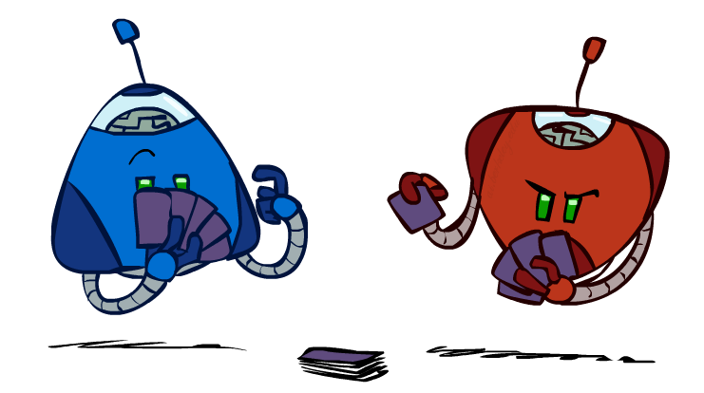
Types of Games
Many different kinds of games!
Axes:
Deterministic or stochastic?
One, two, or more players?
Zero sum?
Perfect information (can you see the state)?
Want algorithms for calculating a strategy (policy) which recommends a move from each state
Figure from Berkley AI

Slide 5
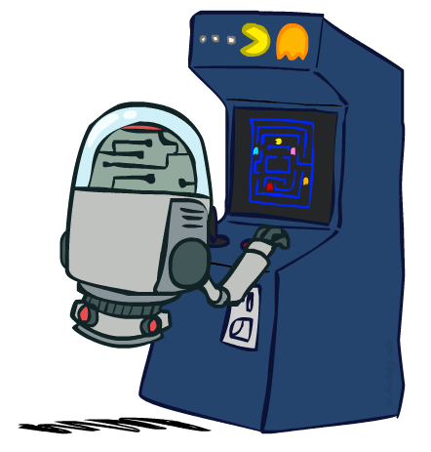
Deterministic Games
Many possible formalizations, one is:
States: S (start at s₀)
Players: P={1...N} (usually take turns)
Actions: A (may depend on player / state)
Transition Function: SxA → S
Terminal Test: S → {t,f}
Terminal Utilities: SxP → R
Solution for a player is a policy: S → A
Figure from Berkley AI

Slide 6
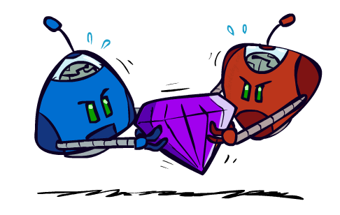
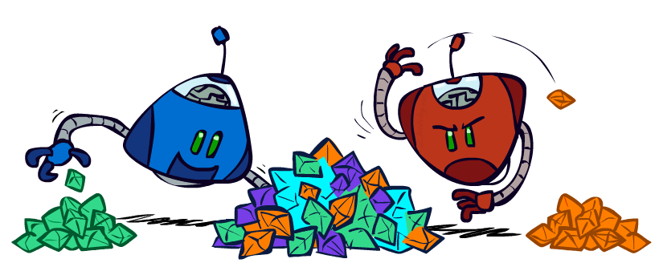
Zero-Sum Games
Zero-Sum Games
Agents have opposite utilities (values on outcomes)
Lets us think of a single value that one maximizes and the other minimizes
Adversarial, pure competition
General Games
Agents have independent utilities (values on outcomes)
Cooperation, indifference, competition, and more are all possible
More later on non-zero-sum games
Figure from Berkley AI

Slide 7

Adversarial Search
Figure from Berkley AI

Slide 8
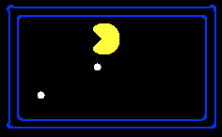
Single-Agent Trees
8
2
0
…
2
6
…
4
6
Figure from Berkley AI

Slide 9
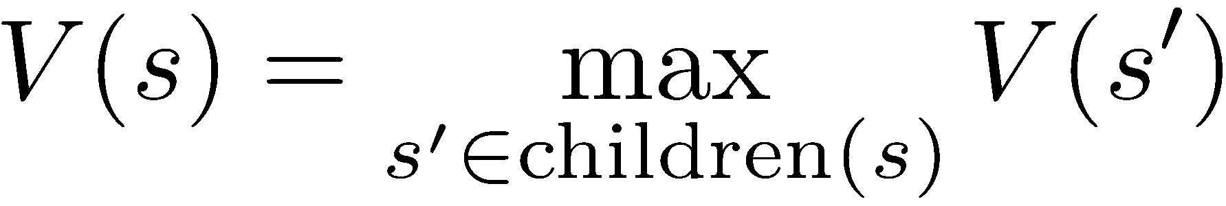
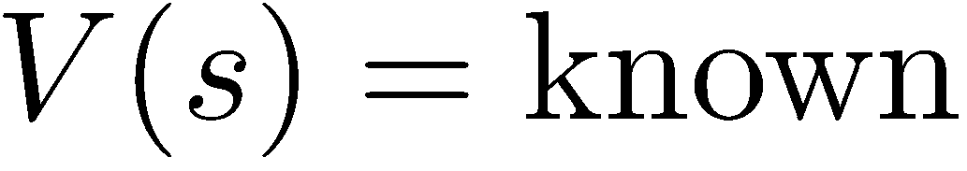
Value of a State
Value of a state: The best achievable outcome (utility) from that state
Non-Terminal States:
8
2
0
…
2
6
…
4
6
Terminal States:
Figure from Berkley AI

Slide 10

Adversarial Game Trees
-20
-8
…
-18
-5
…
-10
+4
-20
+8
Figure from Berkley AI

Slide 11
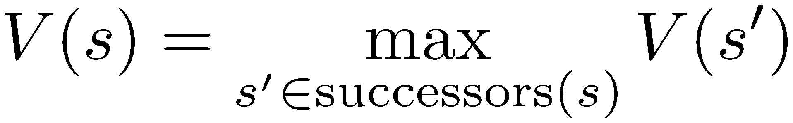
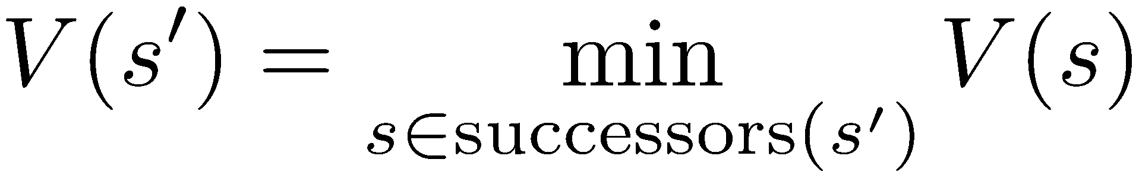
Minimax Values
States Under Agent’s Control:
States Under Opponent’s Control:
-8
-5
-10
+8
Terminal States:
Figure from Berkley AI

Slide 12

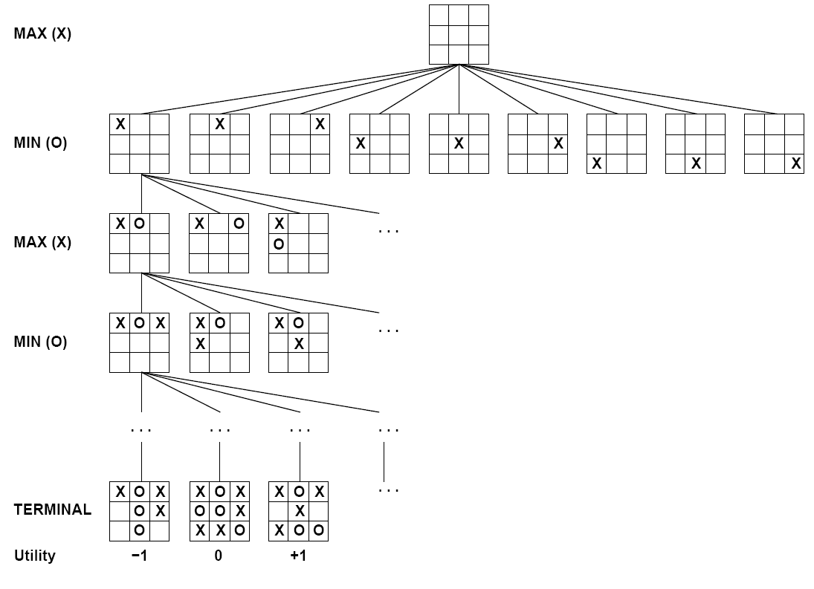

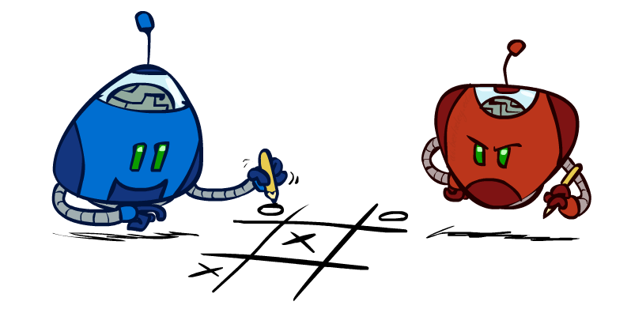
Tic-Tac-Toe Game Tree
Figure from Berkley AI

Slide 13
Adversarial Search (Minimax)
Deterministic, zero-sum games:
Tic-tac-toe, chess, checkers
One player maximizes result
The other minimizes result
Minimax search:
A state-space search tree
Players alternate turns
Compute each node’s minimax value: the best achievable utility against a rational (optimal) adversary
Minimax values: computed recursively
5
max
2
5
min
8
2
5
6
Terminal values: part of the game
Figure from Berkley AI

Slide 14
Minimax Implementation
def max-value(state):
initialize v = -∞
for each successor of state:
v = max(v, min-value(successor))
return v
def min-value(state):
initialize v = +∞
for each successor of state:
v = min(v, max-value(successor))
return v
Figure from Berkley AI
Notes:
Demo:
CS188 javascript demos -> source -> exercises -> csps -> CSPs demos -> CSPs demos.html
Settings:
Graph = Complex
Algorithm = Backtracking
Ordering = MRV

Slide 15
Minimax Implementation (Dispatch)
def value(state):
if the state is a terminal state: return the state’s utility
if the next agent is MAX: return max-value(state)
if the next agent is MIN: return min-value(state)
def max-value(state):
initialize v = -∞
for each successor of state:
v = max(v, value(successor))
return v
def min-value(state):
initialize v = +∞
for each successor of state:
v = min(v, value(successor))
return v
Figure from Berkley AI

Slide 16
Minimax Example
3
12
8
2
4
6
14
5
2
Figure from Berkley AI

Slide 17
Minimax Efficiency
How efficient is minimax?
Just like (exhaustive) DFS
Time: O(b^{m})
Space: O(bm)
Example: Chess, b ≈35, m ≈ 100
Exact solution is completely infeasible
Do we need to explore the entire tree?
Figure from Berkley AI

Slide 18
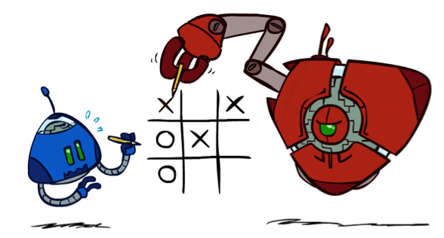
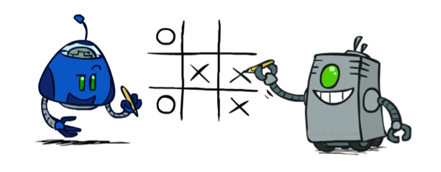
Minimax Properties
max
min
10
10
9
100
Optimal against a perfect player. Otherwise?
Figure from Berkley AI

Slide 19
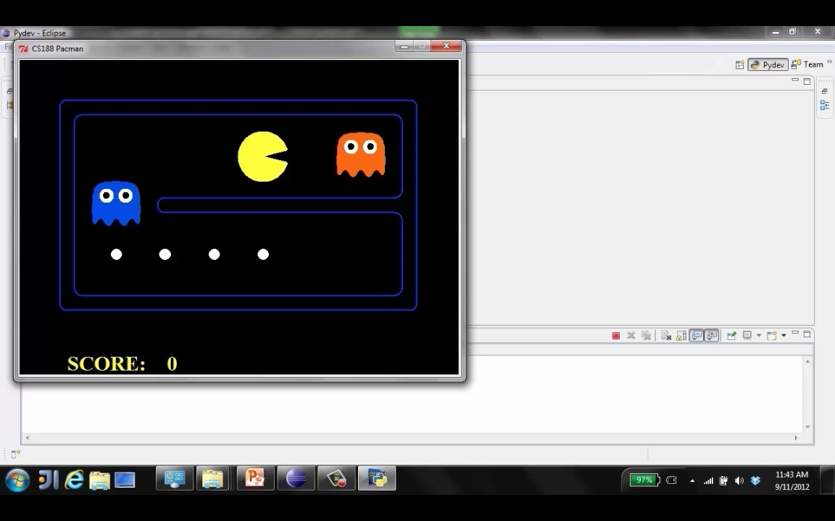
Video of Demo Min Vs Exp (Min)
Figure from Berkley AI

Slide 20
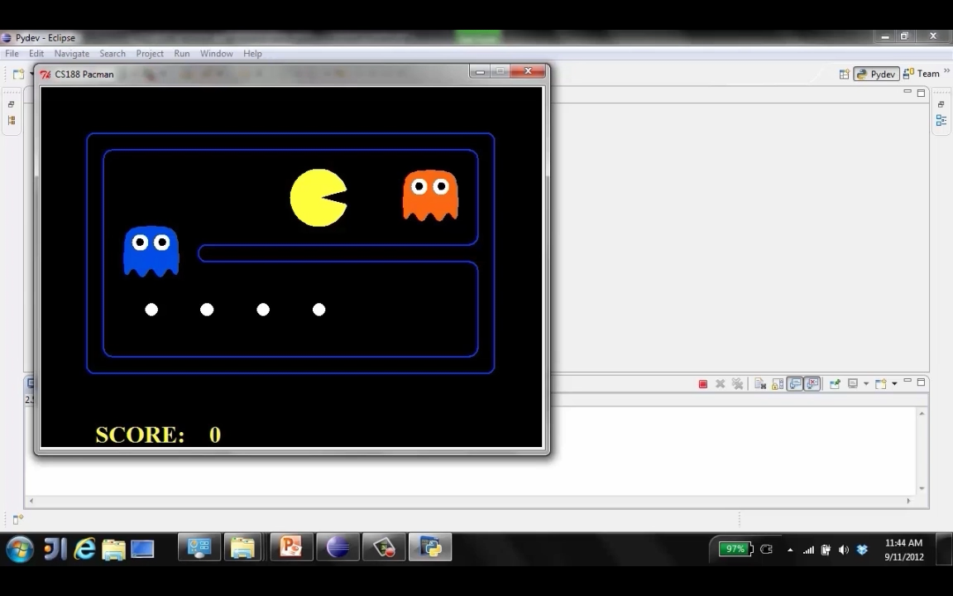
Video of Demo Min vs Exp (Exp)
Figure from Berkley AI

Slide 21
Resource Limits
Problem: In realistic games, cannot search to leaves!
Solution: Depth-limited search
Instead, search only to a limited depth in the tree
Replace terminal utilities with an evaluation function for non-terminal positions
Example:
Suppose we have 100 seconds, can explore 10K nodes / sec
So can check 1M nodes per move
α-β reaches about depth 8 – decent chess program
Guarantee of optimal play is gone
More plies makes a BIG difference
Use iterative deepening for an anytime algorithm
max
4
-2
4
min
-1
-2
4
9
?
?
?
?
Figure from Berkley AI

Slide 22
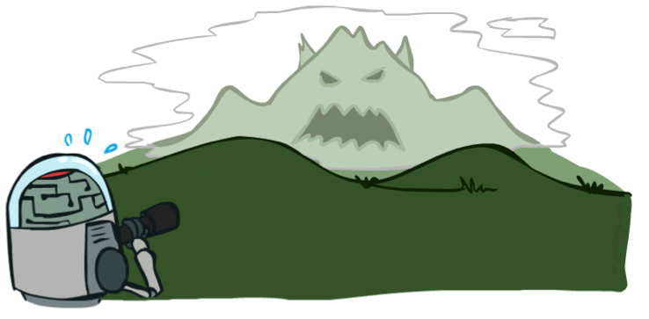

Search Depth Matters
Evaluation functions are always imperfect
The deeper in the tree the evaluation function is buried, the less the quality of the evaluation function matters
An important example of the tradeoff between complexity of features and complexity of computation
Figure from Berkley AI

Slide 23
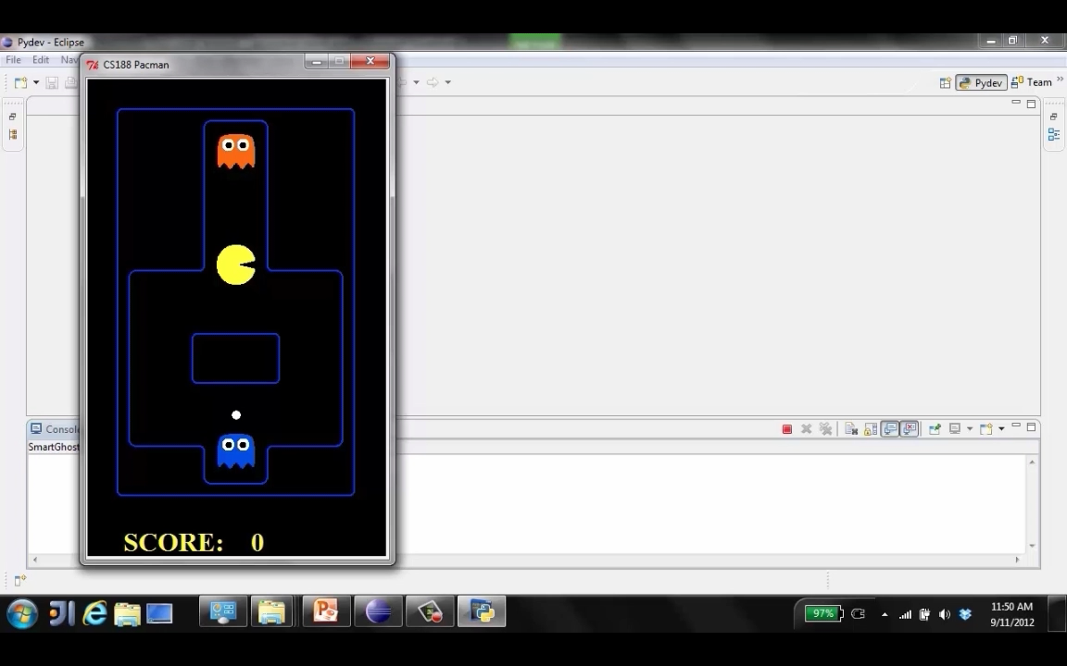
Demo Limited Depth (2)
Figure from Berkley AI

Slide 24
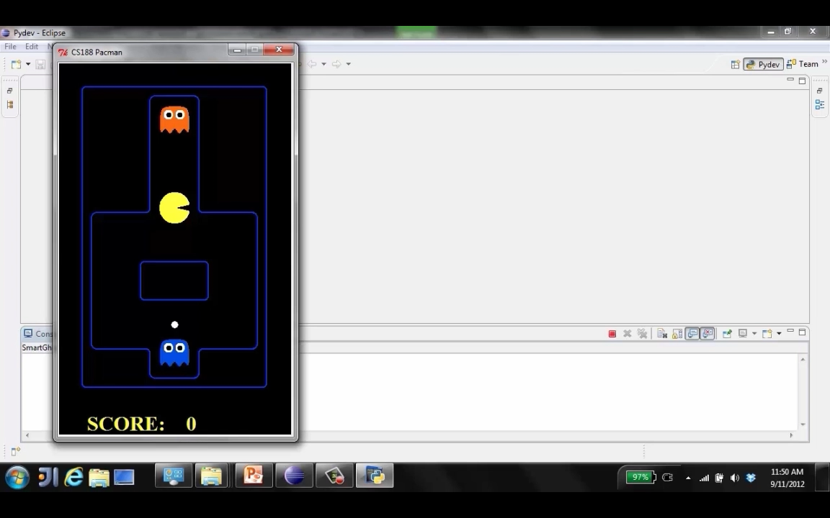
Demo – Depth Limited (10)
Figure from Berkley AI

Slide 25
Evaluation Functions
Evaluation functions score non-terminals in depth-limited search
Ideal function: returns the actual minimax value of the position
In practice: typically weighted linear sum of features:
e.g. f₁(s) = (num white queens – num black queens), etc.
Figure from Berkley AI

Slide 26
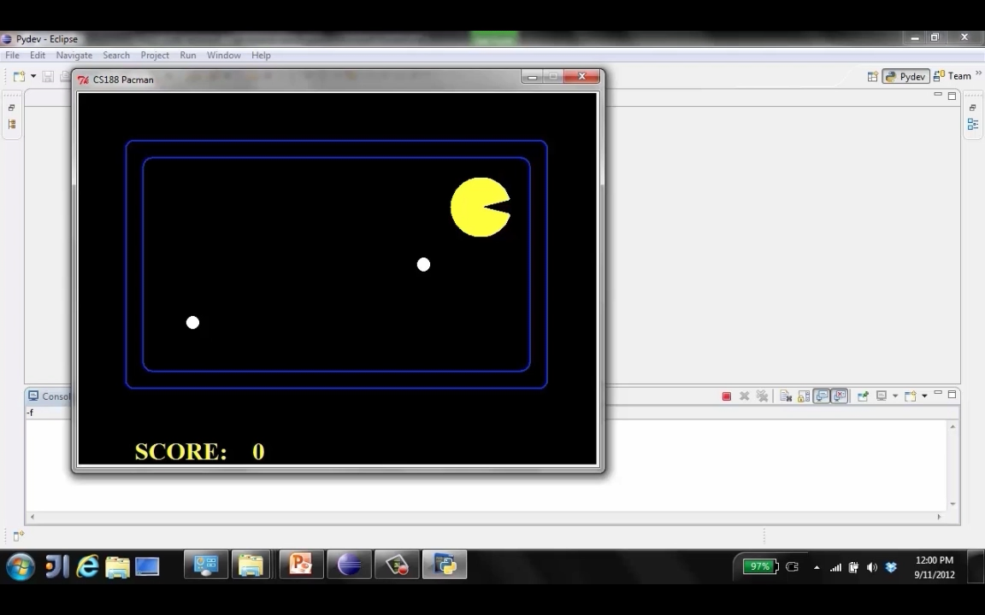
Evaluation for Pacman – Thrashing (d=2)
Figure from Berkley AI

Slide 27
Why does Pacman Thrash and Starve
A danger of replanning agents!
He knows his score will go up by eating the dot now (west, east)
He knows his score will go up just as much by eating the dot later (east, west)
There are no point-scoring opportunities after eating the dot (within the horizon, two here)
Therefore, waiting seems just as good as eating: he may go east, then back west in the next round of replanning!
Figure from Berkley AI

Slide 28
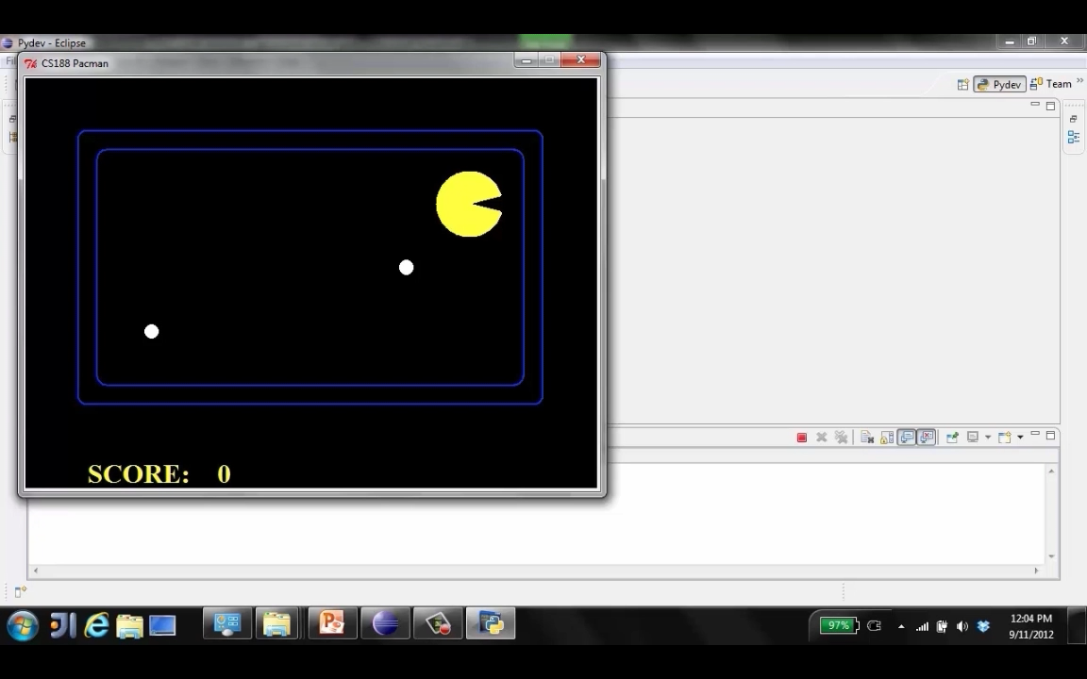
Video – Thrashing Resolved – Fixed (d=2)
Evaluation function includes proximity to the nearest food pellet.
Figure from Berkley AI

Slide 29
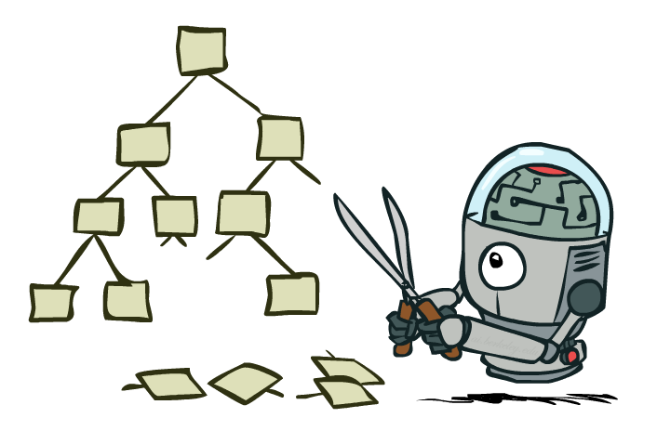
Game Tree Pruning
Figure from Berkley AI

Slide 30
Game Tree Pruning
3
12
8
2
4
6
14
5
2
Figure from Berkley AI

Slide 31
Alpha-Beta Pruning
General configuration (MIN version)
We’re computing the MIN-VALUE at some node n
We’re looping over n’s children
n’s estimate of the childrens’ min is dropping
Who cares about n’s value? MAX
Let a be the best value that MAX can get at any choice point along the current path from the root
If n becomes worse than a, MAX will avoid it, so we can stop considering n’s other children (it’s already bad enough that it won’t be played)
MAX version is symmetric
MAX
MIN
a
MAX
MIN
n
Figure from Berkley AI

Slide 32
Alpha-Beta Pruning
3
4
5
2
1
Figure from Berkley AI

Slide 33
Alpha-Beta Pruning Properties
This pruning has no effect on minimax value computed for the root!
Values of intermediate nodes might be wrong
Important: children of the root may have the wrong value
So the most naïve version won’t let you do action selection
Good child ordering improves effectiveness of pruning
With “perfect ordering”:
Time complexity drops to O(b^{m/2})
Doubles solvable depth!
Full search of, e.g. chess, is still hopeless…
This is a simple example of metareasoning (computing about what to compute)
max
min
10
10
0
Figure from Berkley AI

Slide 34
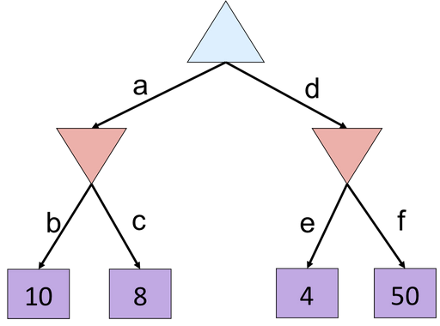
Alpha Beta Quiz
Figure from Berkley AI

